Slide 1
MCTV Presentation
Group Q: Fouad Animashaun (Leader), Ciaran brady, Joshua Hall and Yuzhang Chen

Slide 2
Introduction to MCTV
MCTV is a small retail company wanting to expand their business to the cloud.
There’s four areas for investment however only one can get the money, sales, marketing, purchasing, and stock management.
Each group member will be tasked with writing an individual report on why their chosen software should get the investment.

Slide 3
An outline of the tasks
We decided as a group how the tasks will be assigned,
Ayo (Mark) – Group leader, wordpress site and uml chart.
Ciaran (Derek) – Microsoft database and github.
Richard (Liam) – Presentation and grant chart.
Josh (Roberta) – Microsoft database and Presentation.

Slide 4

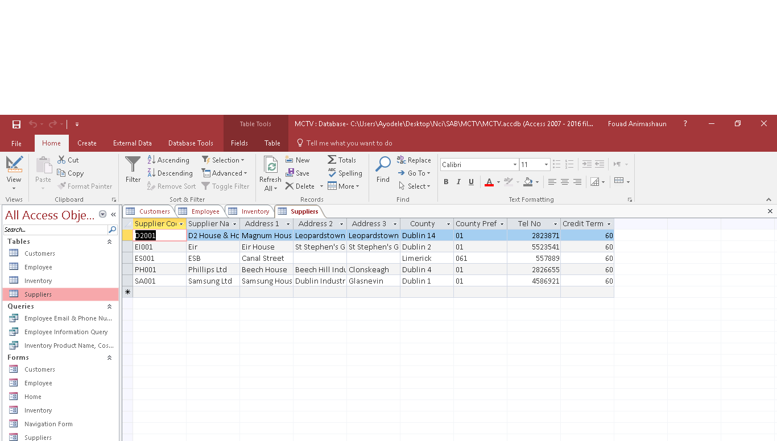
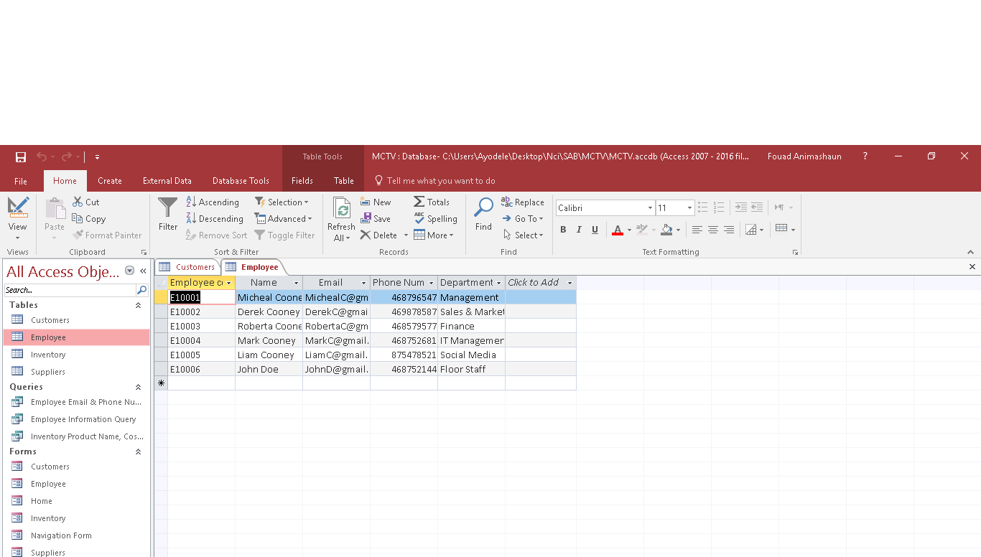
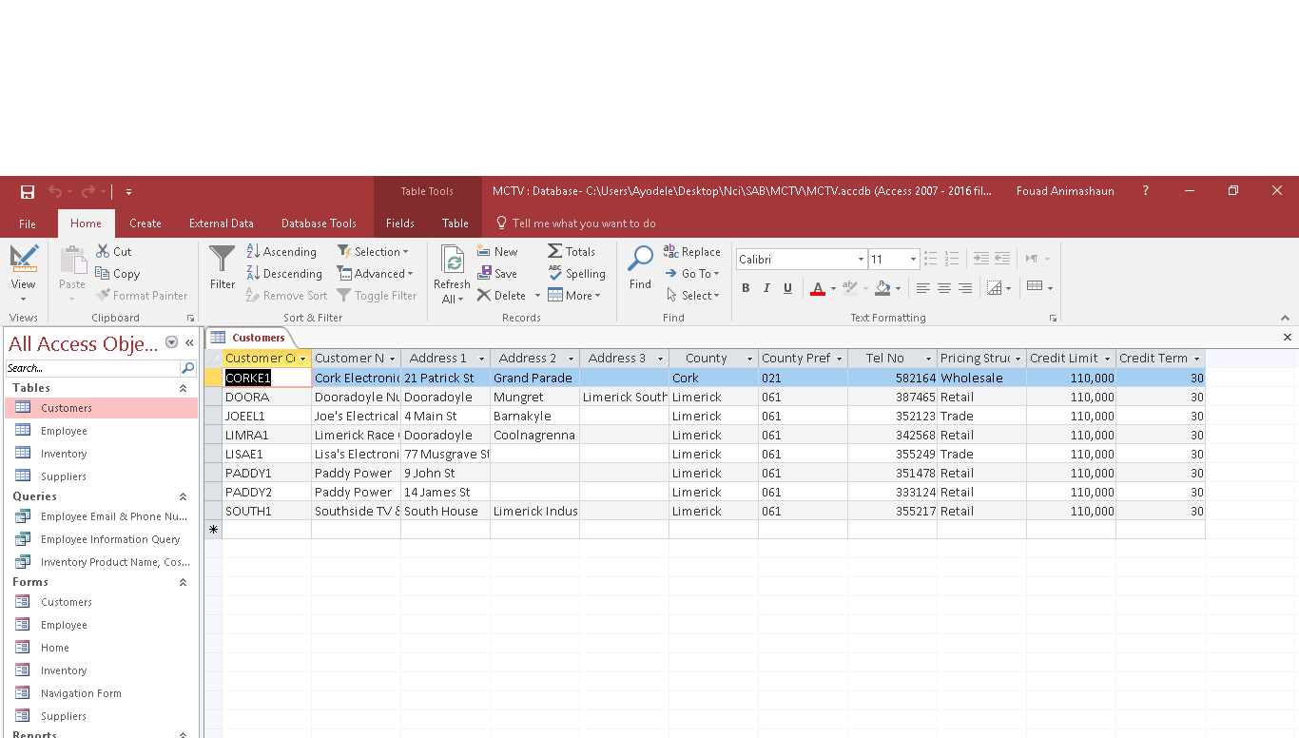
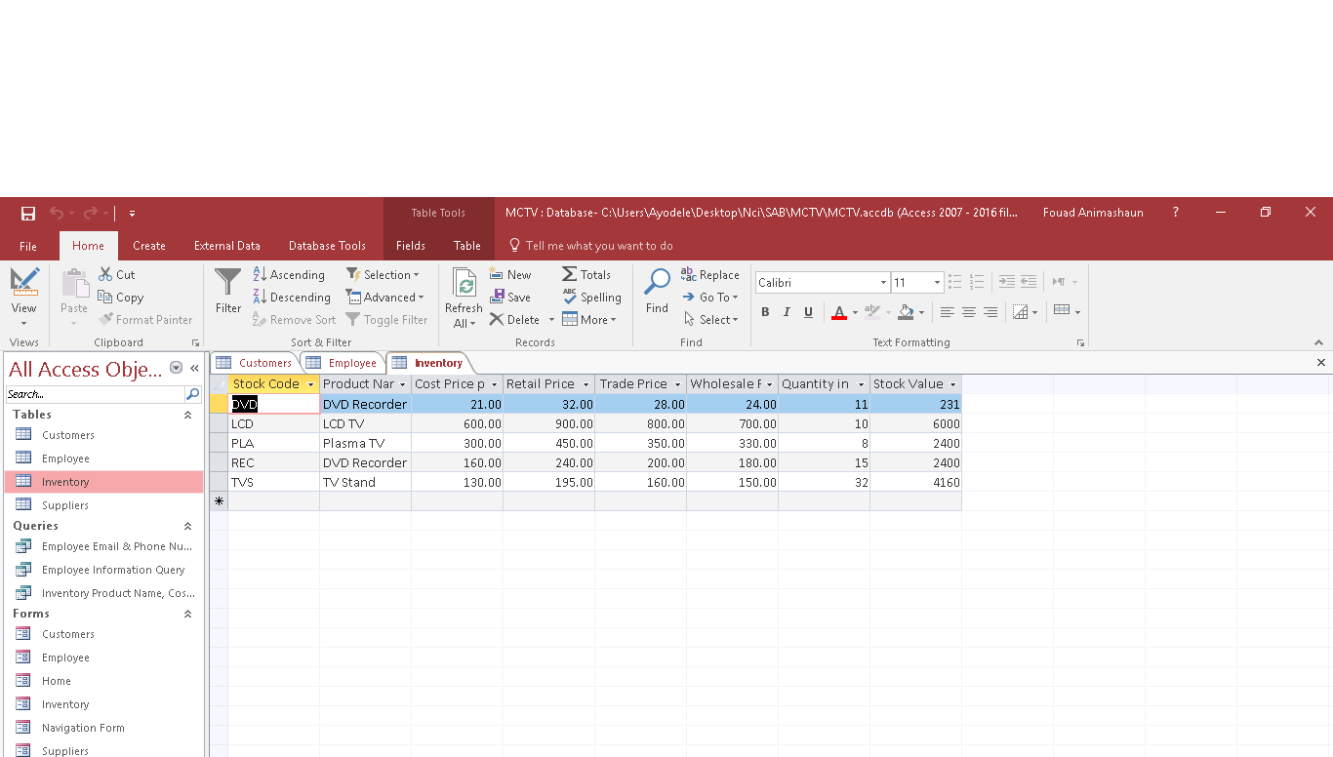
Overview of Database
We decided to create a table, for each of the headings customers, employees, inventory and suppliers.

Slide 5
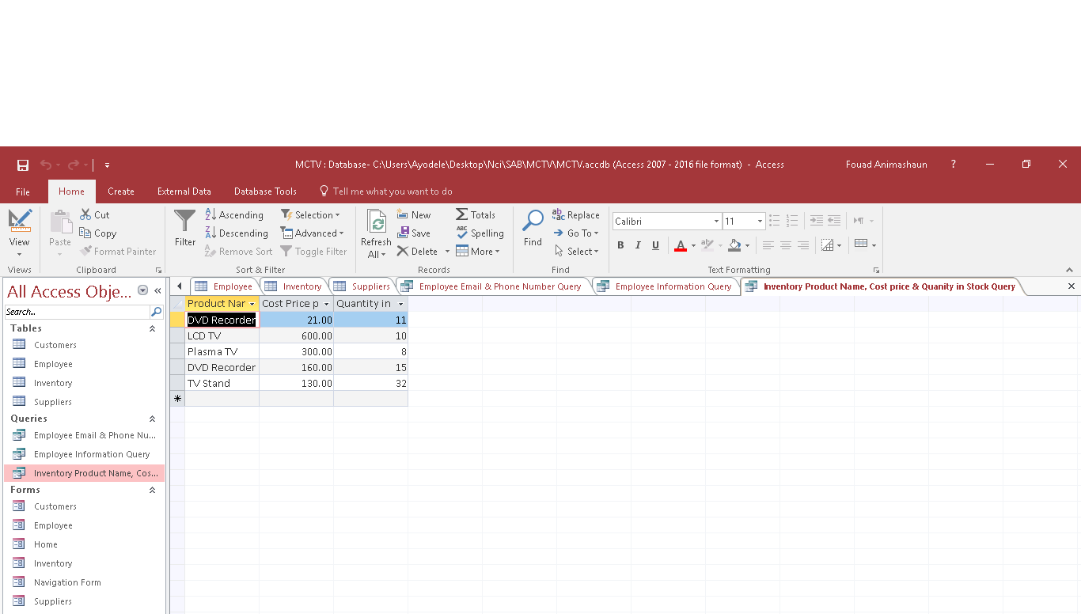
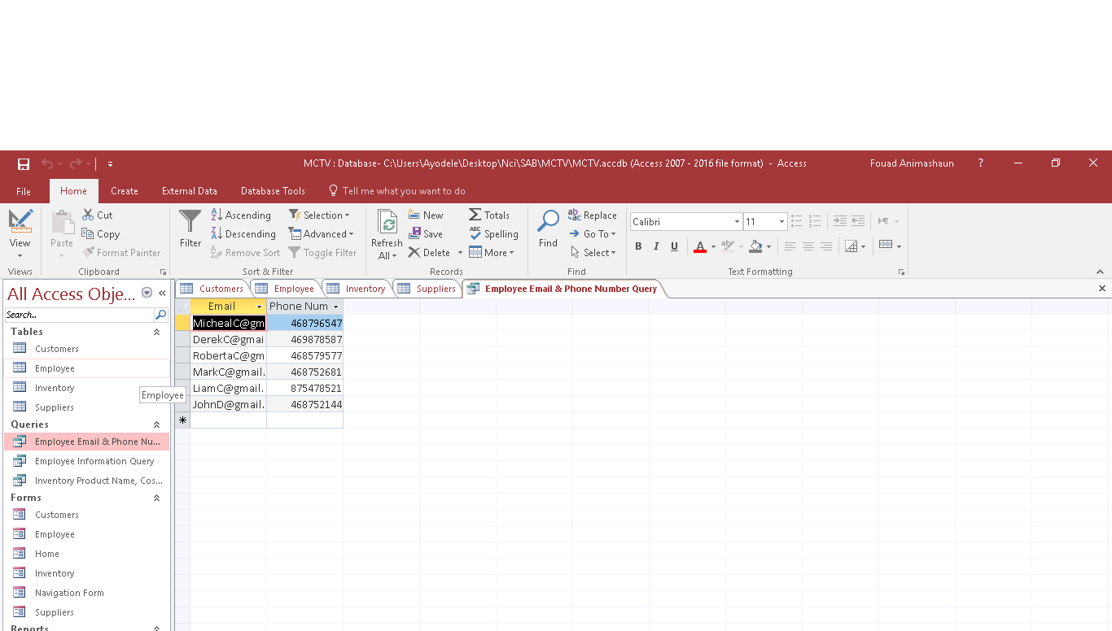
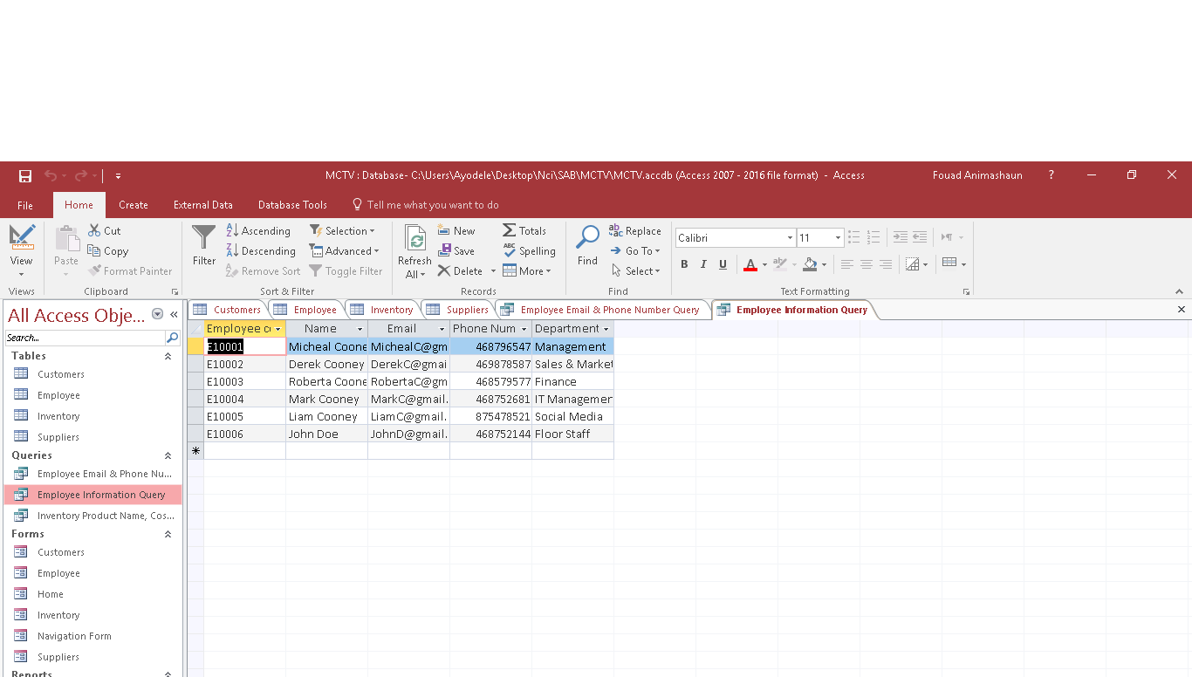
Overview of Database
Under the queries heading we created a table for each of the following headings, Employee email and phone number query, Employee Information query, and inventory product name, cost & quantity in stock query.

Slide 6
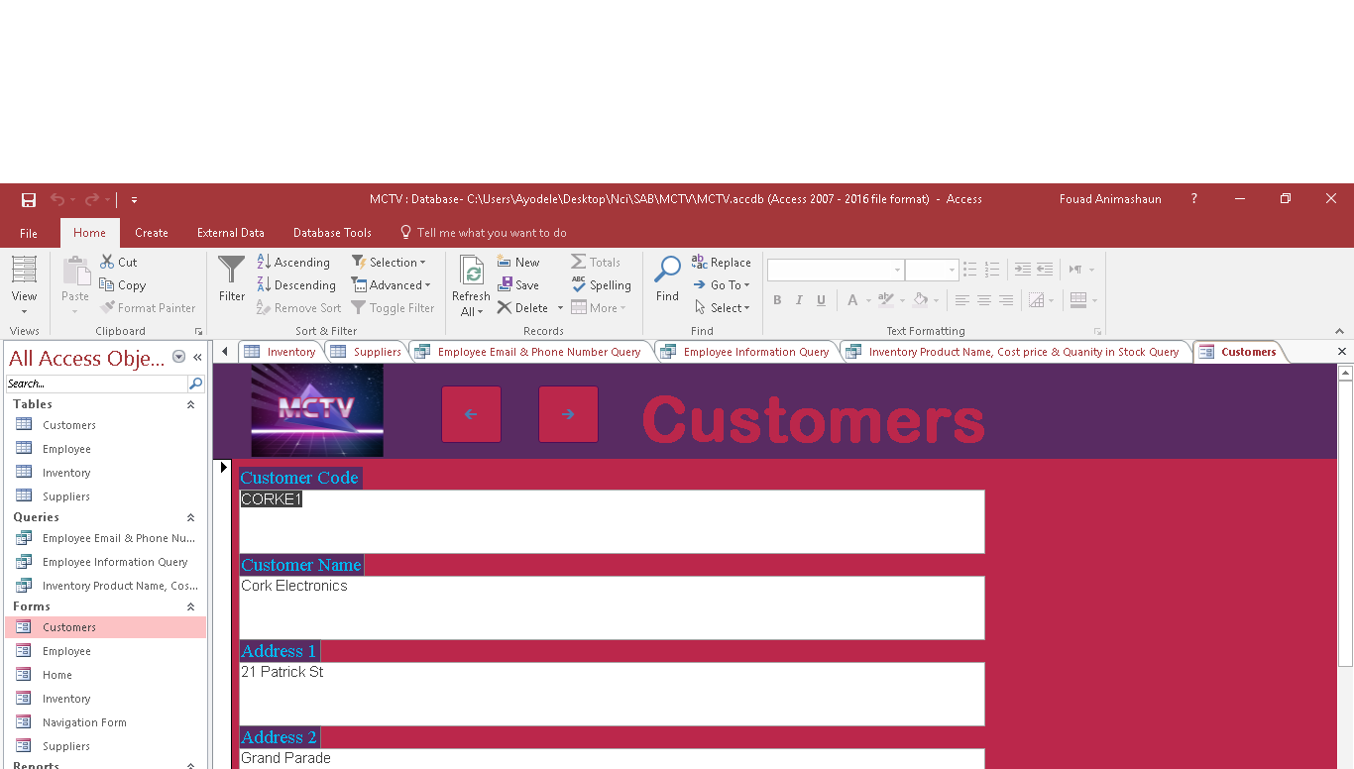
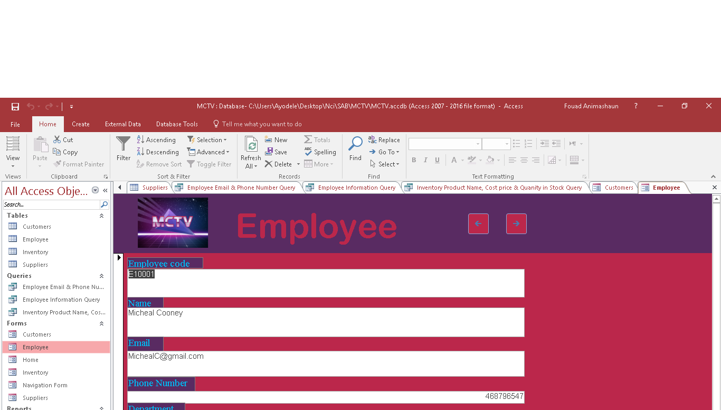
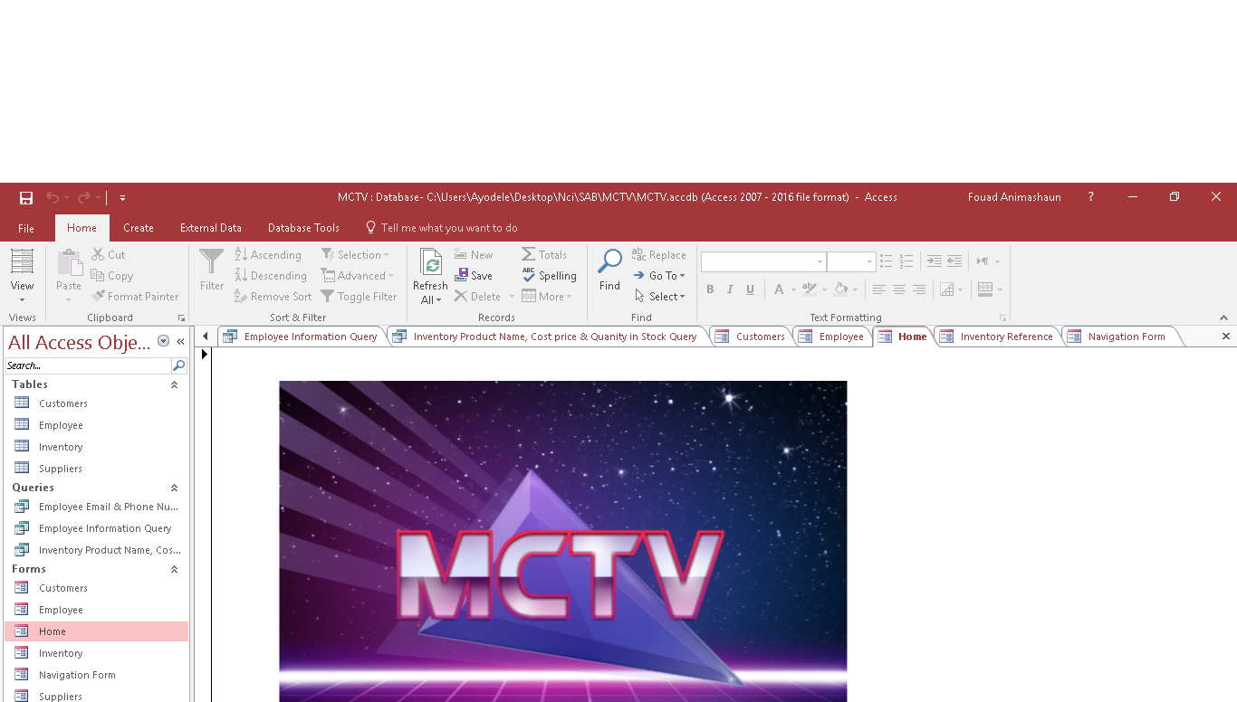
Overview of Database
Here we created forms for easy entry of customer, employee and inventory data.

Slide 7
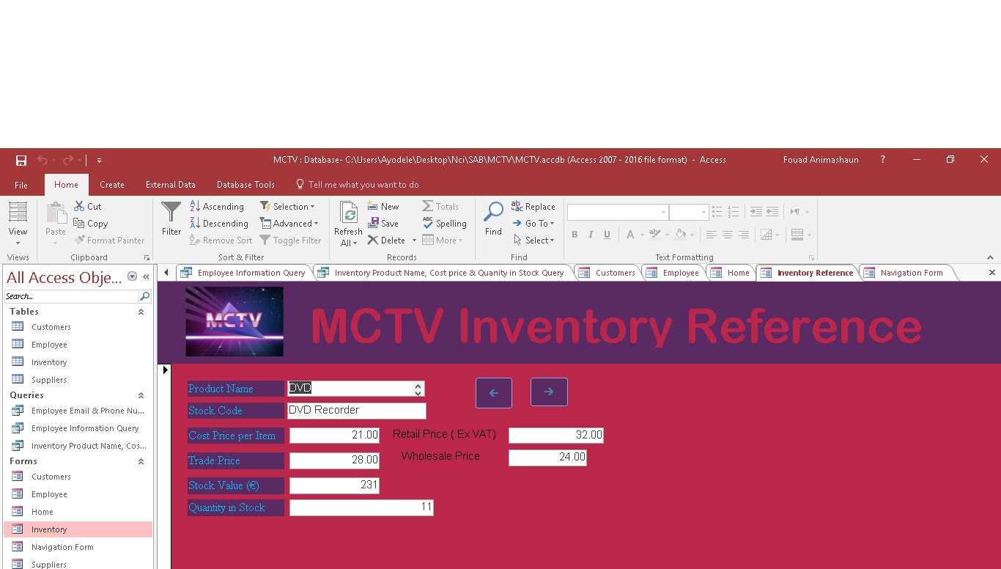
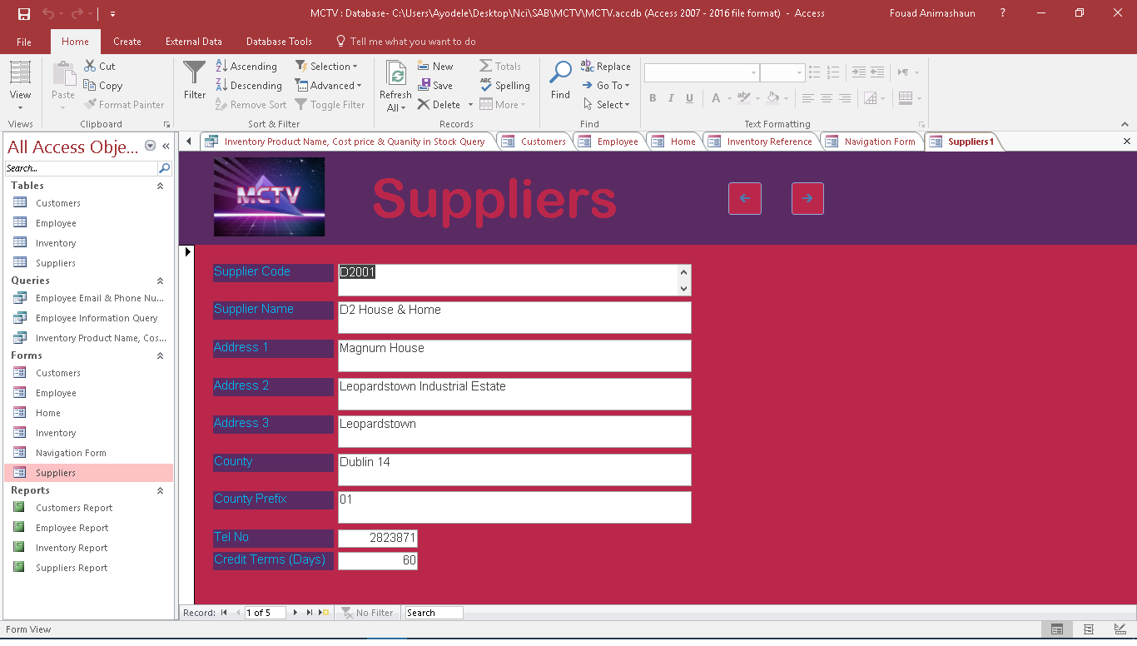
Overview of Database

Slide 8
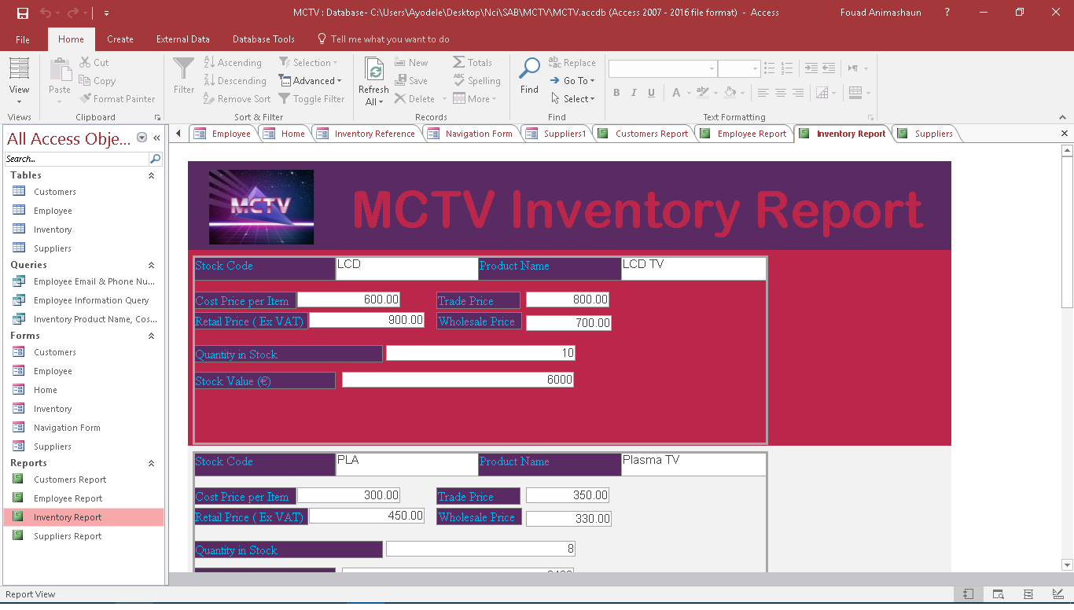
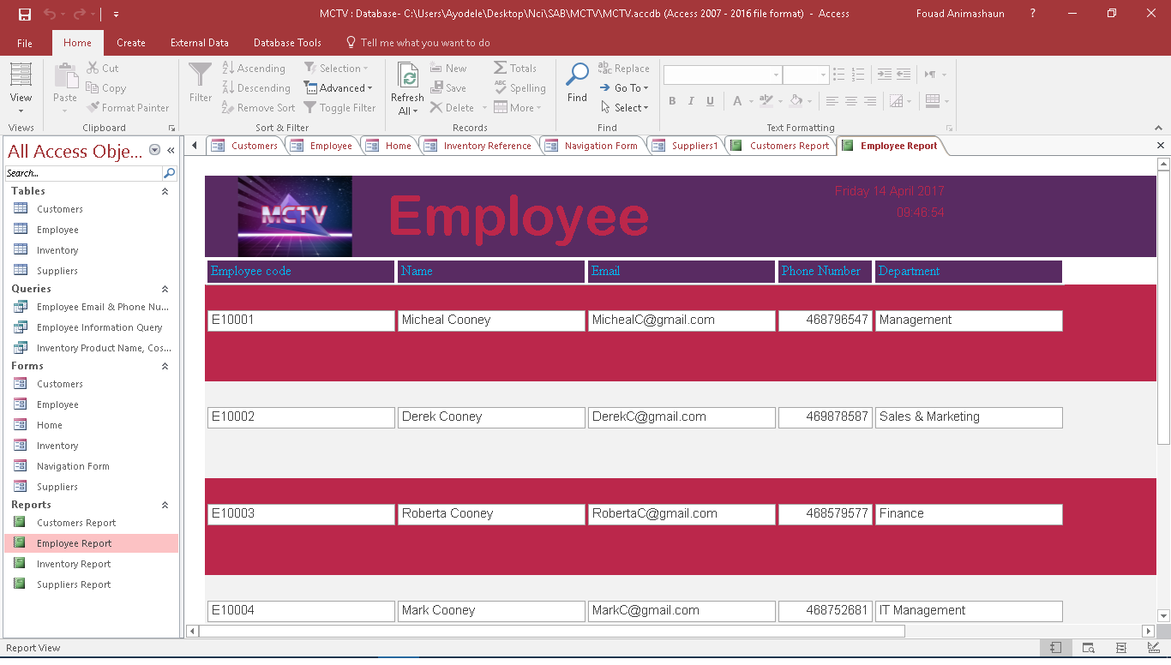
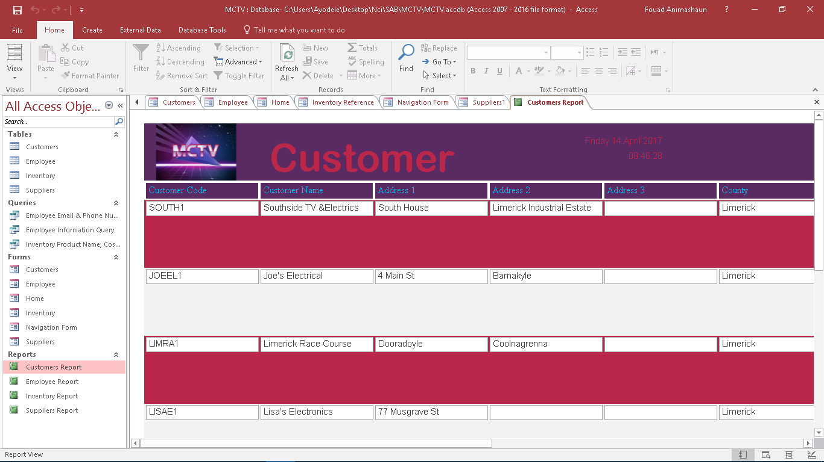
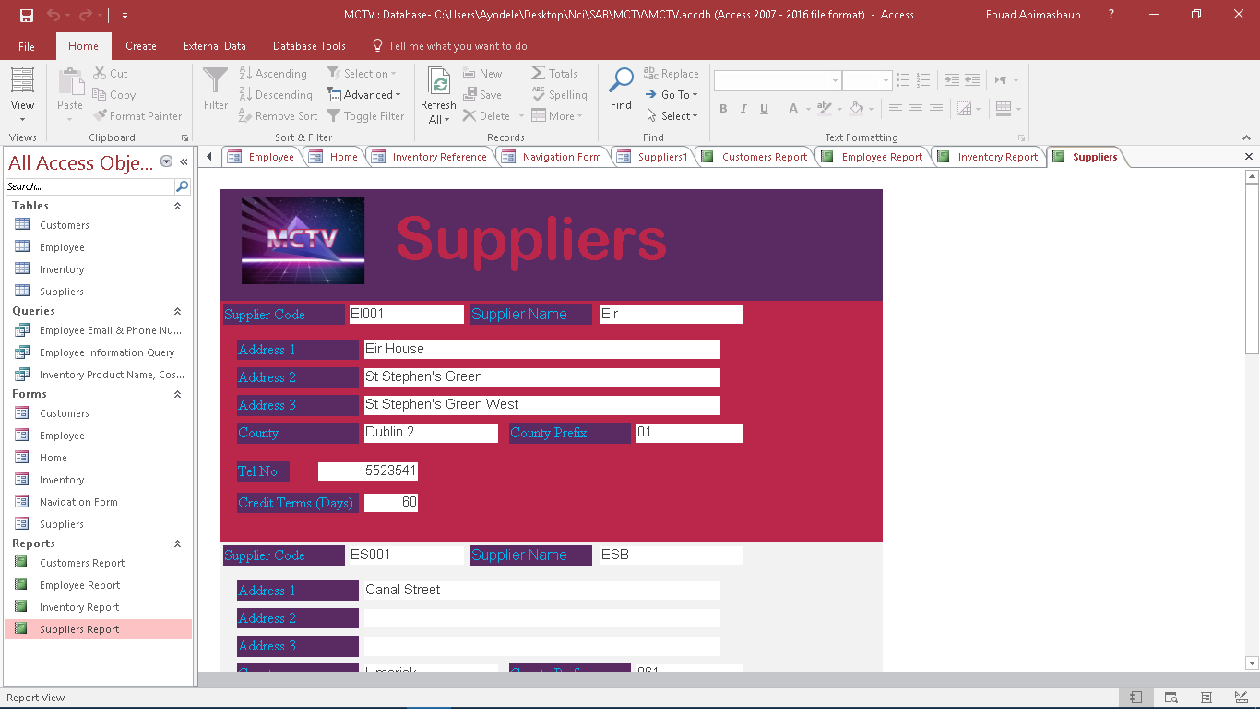
Overview of Database
We have 4 automatically generated report, showing the list for suppliers, employee, inventory and customers.

Slide 9
Overview of UML

Slide 10
User guides

Slide 11

Branding and Colour scheme

Slide 12
Conclusion

